Slide 1



Capstone Project Presentation
Electric Vehicle Ecosystem for Navigation (EVOS)
Team Members:
Mentor:
G Pragnya Reddy (70572200054)
Narahari Abhinav (70572200031)
Prof. Vinayak Mukkawar
, HYDERABAD

Slide 2
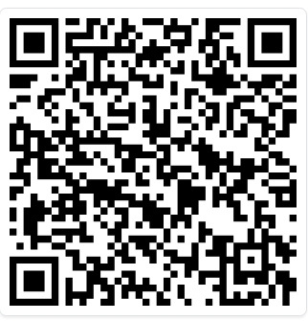
Scan the App

Slide 3
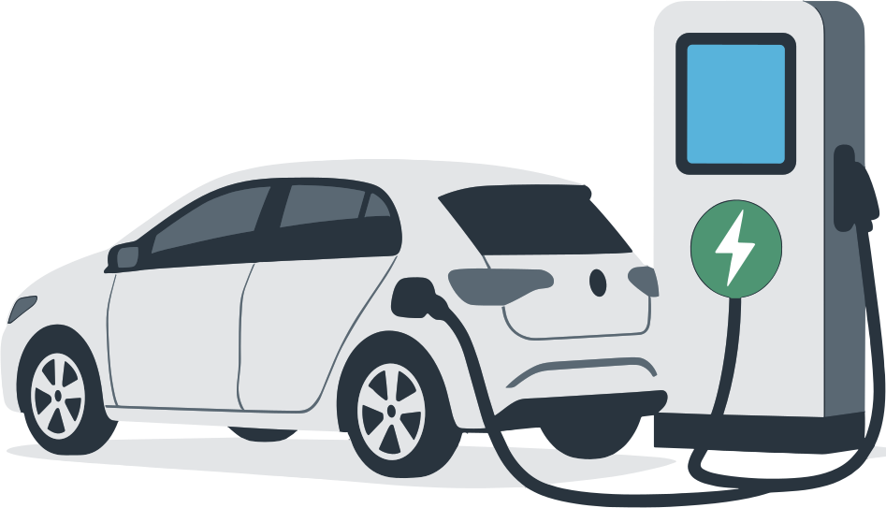
Abstract
The adoption of electric vehicles in India is limited by unreliable charging information, range anxiety, and the lack of integrated navigation and emergency support.
This project addresses these issues by developing a unified mobile application that provides real-time charging station discovery, intelligent route guidance based on battery levels, and instant SOS assistance.
The system is built using a cross-platform framework with a cloud-based backend, real-time database, and Google Maps APIs.
The approach includes modules for authentication, station mapping, dynamic routing, emergency support, and community-driven station contributions.
Results show fast station retrieval, accurate polyline navigation, effective emergency response, and scalable data growth
through user submissions.

Slide 4
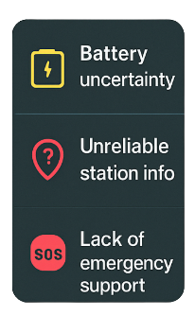

Motivation / Purpose
Motivation :
The growth of electric vehicles in India is held back by range anxiety, unreliable charging information, and the lack of dependable emergency assistance. Existing applications offer static or outdated station lists, making long-distance travel difficult and unsafe for users.
Purpose :
This project aims to provide a trustworthy, real-time navigation solution that helps drivers easily locate verified charging stations, plan routes intelligently based on battery levels, and access instant emergency support. The overall purpose is to improve safety, confidence, and convenience for EV users across India.

Slide 5






Novelty of Idea
01
02
03
04
Not just a map -
A smart ecosystem
Battery-aware navigation
Community-driven growth
Integrated emergency support
One app for stations, routing, and safety.
Routes based on battery level.
Users can add verified charging stations
Helps users to connect nearby service providers.

Slide 6



Objectives/Scope of Project
Provide real-time charging station visibility with accurate location, status, and details.
Mobile app for EV navigation & assistance.
Offer smart navigation that plans routes based on the user’s current battery level and distance.
Real-time charging station mapping.
Enable quick emergency support by connecting users to nearby towing or repair services.
SOS emergency support.
Maintain a community-driven database where users can add new stations with photos and GPS.
User-added station contributions.
Ensure a secure and scalable system using a cloud backend, real-time database, and cross-platform mobile app.
Admin verification of new stations.

Slide 7
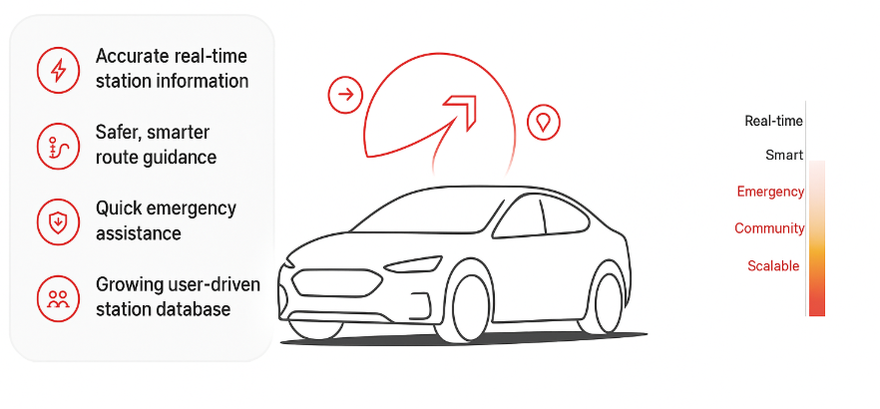
Expected Outcomes

Slide 8







Tools & Technologies / Domain / SDG
Tools & Technologies:
Domains:
Frontend: React Native (cross-platform mobile app)
Electric Mobility, Real-Time Navigation, Mobile Computing, Cloud-Based Systems.
Backend: Firebase (Auth, Firestore, Storage)
Aligned SDGs:
Maps & Routing: Google Maps SDK, Directions API
Other Tech: Expo, React-Native-Maps, Geo-location services
SDG 7 – Affordable & Clean Energy
SDG 9 – Industry, Innovation & Infrastructure
SDG 11 – Sustainable Cities & Communities

Slide 9
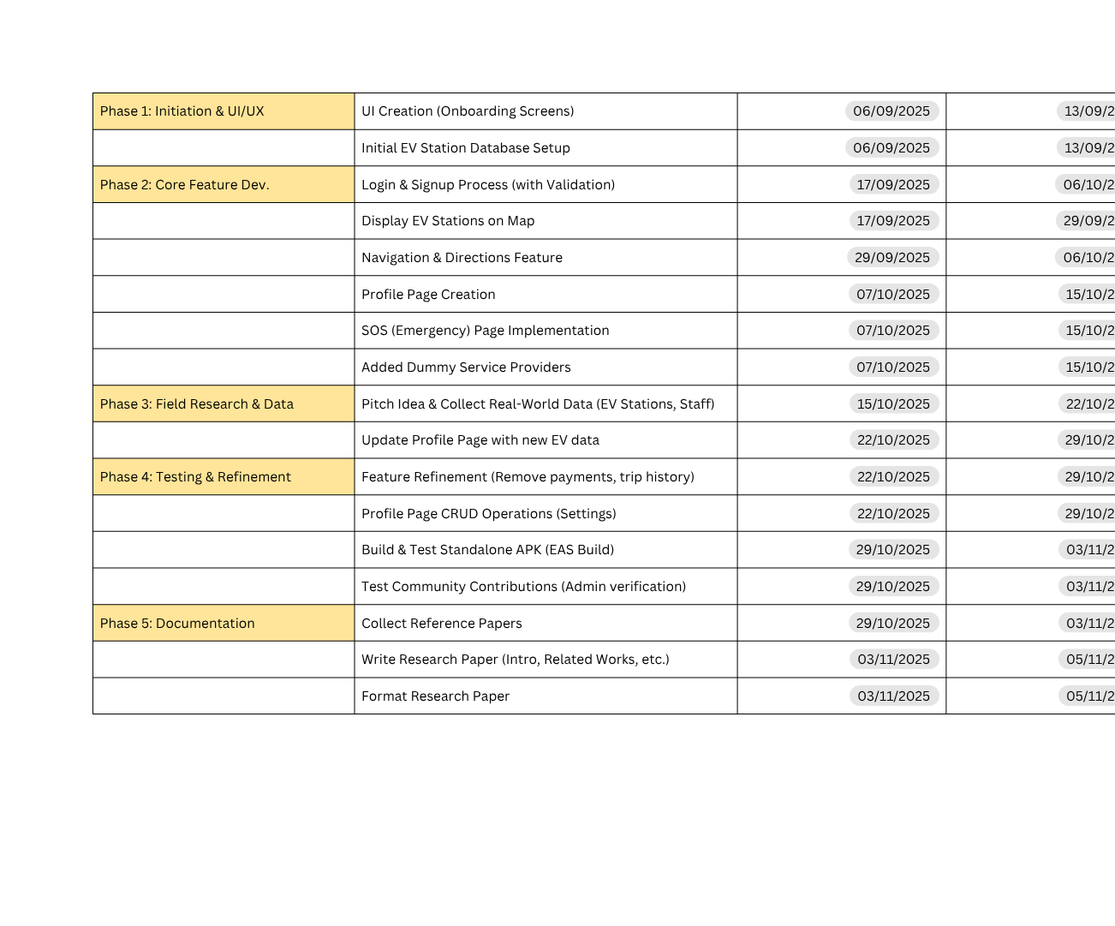
Project Schedule (Gantt Chart)

Slide 10
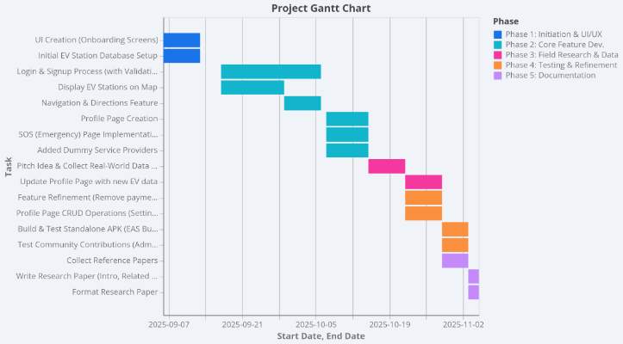
Project Schedule (Gantt Chart)

Slide 11
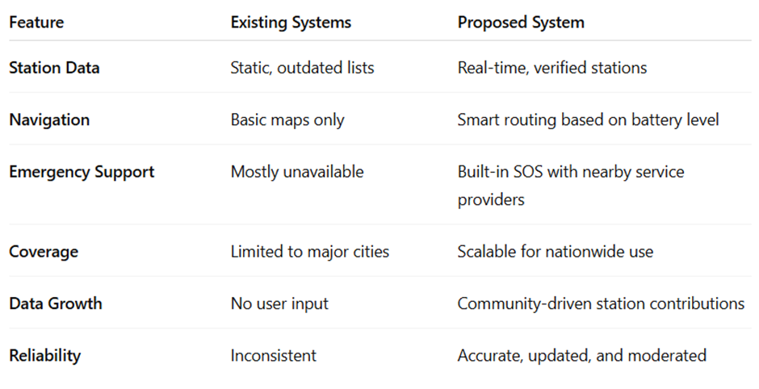
Literature Review

Slide 12



UseCase diagrams
Login / Signup
Approve or reject user added stations
View Real-Time Charging Startions
Edit , update or remove station details
ELECTRIC VEHICLE ECOSYSTEM FOR NAVIGATION (APP)
Users
Starts Navigation using Maps
Monitors Charging Stations
Admin
Trigger SOS for Help
View the Status of contributions
Contribution for Charging Stations
Responds to SOS alerts (if required )

Slide 13
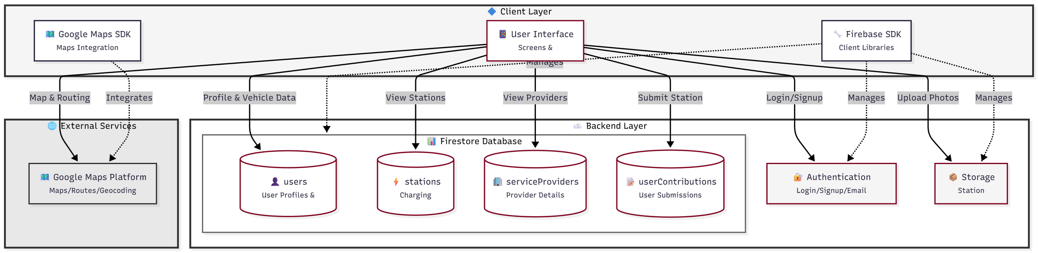
Methodology with diagrams
1.Overall System Architecture

Slide 14
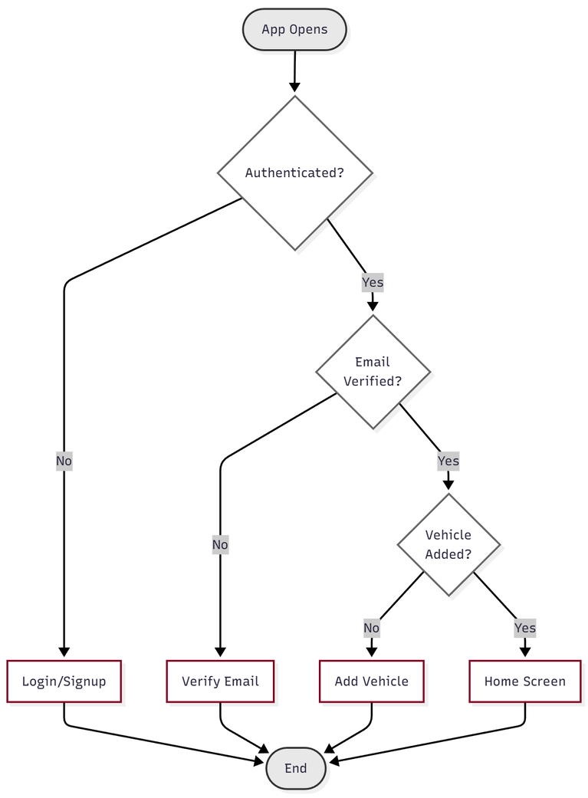
Methodology with diagrams
2. User Authentication & Profile Flow.
Start: User opens the app.
Auth Loading: AuthContext checks for a user.
Decision (User exists?):
No: Show Login/Signup screens.
Yes: Proceed to next check.
Decision (Email Verified?):
No: Redirect to verify-email screen.
Yes: Proceed to next check.
Decision (Vehicle Added?):
No: Redirect to addVehicle screen.
Yes: Redirect to home screen.
End: User is in the app.

Slide 15
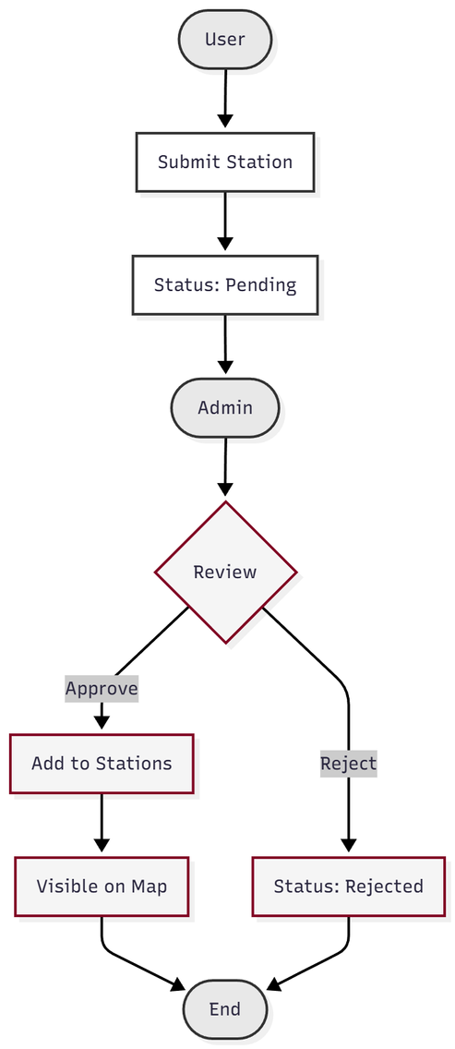
Methodology with diagrams
3. Community Contribution & Admin Verification Flow
User: A user (role: 'user') opens the contribute-station screen.
App: The app uploads the photo(s) to Firebase Storage.
App: The app creates a new document in the userContributions collection with status: 'pending'.
Admin: An admin (role: 'admin') opens the admin screen and views the 'Pending' tab.
Admin: The admin reviews the submission and clicks "Approve."
App: The approveContribution function is triggered.
Backend: This function:
Creates a new document in the public stations collection.
Updates the document in userContributions to status: 'approved'.
End: The new station is now visible to all users on the map.

Slide 16

Results
Real-time station mapping works smoothly with instant updates.
Accurate turn-by-turn navigation using Google Directions API.
SOS module responds quickly with nearest emergency services.
User-added stations successfully stored & verified through admin panel.
Fast data sync using Firebase (low latency, real-time listeners).
Stable prototype tested on real device with consistent performance.

Slide 17
Technical Implementation, Module Integration, and System Accuracy
Algorithms & Techniques Used
Firebase Authentication with secure email verification
Firestore NoSQL database for users, stations, contributions, SOS
Google Maps Directions API for routing & polylines
Haversine distance formula for accurate distance calculation
Firebase Storage for image upload and URL linking
Accurate System Functionality
Role-based access: Only admins can open admin panel
SOS filtering based on problem type (battery, towing, repair)
Real-time GPS tracking and map updates
Precise station mapping using GeoPoints
Strong Module Integration
Auth → Profile → Home → Navigation flow works smoothly
Vehicle data integrated with SOC tracking during routing
User contributions flow into Admin approval → then appear on Home map
Real-time updates shared across all modules
Objectives Successfully Achieved
Secure authentication & profile management
Real-time EV station discovery & navigation
Emergency SOS support
Vehicle-based personalization (range, SOC)
Community contribution of stations
Admin dashboard for verification

Slide 18
Conclusion
The project delivers a unified platform that supports EV users with real-time charging station discovery, smart navigation, and emergency assistance. By combining cloud technologies, accurate mapping, and user contributions with admin verification, the system reduces range anxiety, improves safety, and maintains reliable station data. The prototype performs smoothly across devices and provides a scalable foundation for future enhancements in the EV ecosystem.
Future Work
Integrate live charger availability using IoT sensors.
Add predictive routing based on SoC, traffic, and region.
Enable in-app payments for charging sessions.
Introduce crowdsourced issue reporting (broken chargers, wait times)
Build AI-based station recommendations and route optimization.
Expand coverage with more verified stations and partners.

Slide 19

Thank You

